Slide 1

Quote Conversion Prediction for Peace of Mind
Team CSRR

Slide 2





OUR DATA SCIENCE TEAM
Cindy Zhang
Rebecca Li
Roch Jia
Susie Li
Data Scientist
Emory MSBA ’23
Data Scientist
Emory MSBA ’23
Data Scientist
Emory MSBA ’23
Data Scientist
Emory MSBA ’23

Slide 3

TABLE OF CONTENTS
01
02
03
Overview
Core Findings & Solutions
Data Exploration
04
05
06
Data Processing
Modeling
Deployment and Intuitions

Slide 4

Overview
01

Slide 5
Overview
The business tasks and the corresponding questions to be answered are:
Provide a well-established, robust and interpretable prediction model for policy conversion rate
How to identify quoted policies that our company will convert?
For each quoted policy, what is the probability of conversion?
Understand the characteristics of the quoted policies
What kinds of vehicle owners are included in the provided dataset?
Address the importance of characteristics for policy conversion
What characteristics in the policies are important for conversion? What are not?
What is the ranking of importance for these characteristics?
Suggest feasible business strategies based on our findings
Customer acquisition strategies: Find out “accurate” customers for advertising
Product Improvement strategies: How to turn low-conversion customers into high-conversion customers

Slide 6

02
Core Solutions

Slide 7
Core Solutions
Prediction
Model
A machine learning prediction model is established to identify whether or not a policy would be converted.
Data Sources: policies, drivers, vehicles
Statistical Model: XGBoost (an advanced tree-based model)
Features Importance: Random Forest and XGBoost (Only informative characteristics are included for the prediction)
Performance: Around 68% in AUC (i.e. classification power)
Notes:
XX% means if you randomly select a policy, the probability of correctly identify whether it is successfully converted is XX%

Slide 8
Core Solutions
Characteristics
Analysis
Characteristics Importance:
Driver age, education level, catastrophe risk zone, vehicle ownership are representative significant features contributing to the model
Prior carriers, primary parking, home policy (existing customers or not) are representative insignificant features
Classification Differences:
Middle-aged, high credit score & high education customers tend to convert the policies
Young, low credit score & low education customers tend not to convert the policies
Notes:
XX% means if you randomly select a policy, the probability of correctly identify whether it is successfully converted is XX%

Slide 9
Core Solutions
Strategy
Portfolio
Based on our analysis, we suggest our operation team to deliver strategies on:
Micro-targeting advertising
Specific marketing tactics for different targeting groups
Manual service Improvement
Notes:
XX% means if you randomly select a policy, the probability of correctly identify whether it is successfully converted is XX%

Slide 10

Data Exploration
03

Slide 11
Data Overview
5876
40587
39028
AVERAGE QUOTED AMOUNT
GENDER
From 15 to 108608
19
1946
Test
12291
brands
models
Train
36871
CAR
49155
Unconverted
32751
Quoted Policy Number
Converted
4120

Slide 12
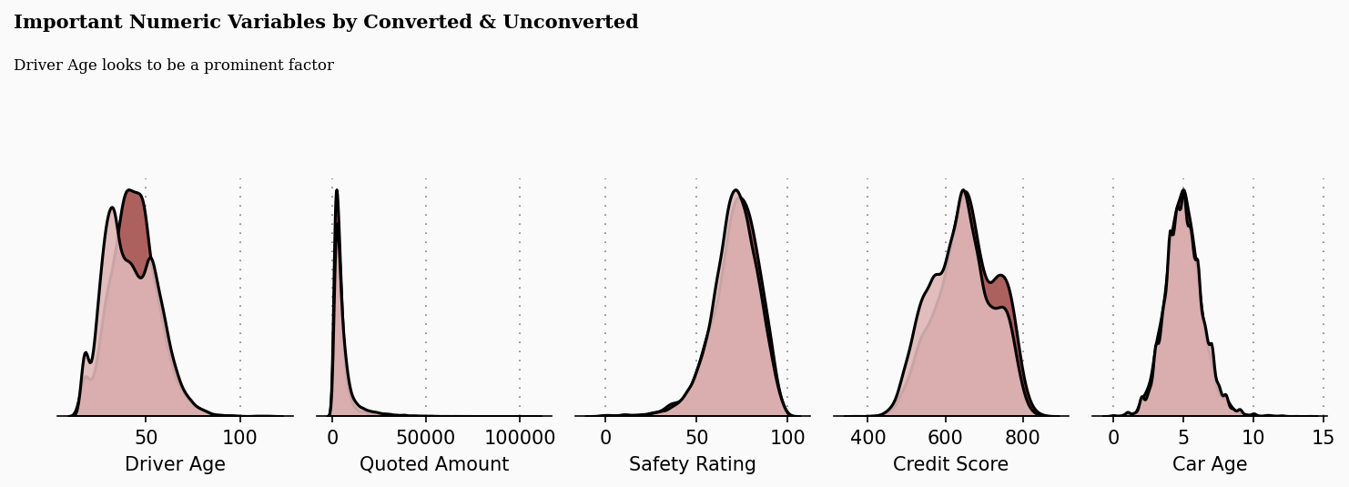
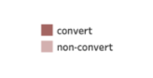
Data Exploration

Slide 13
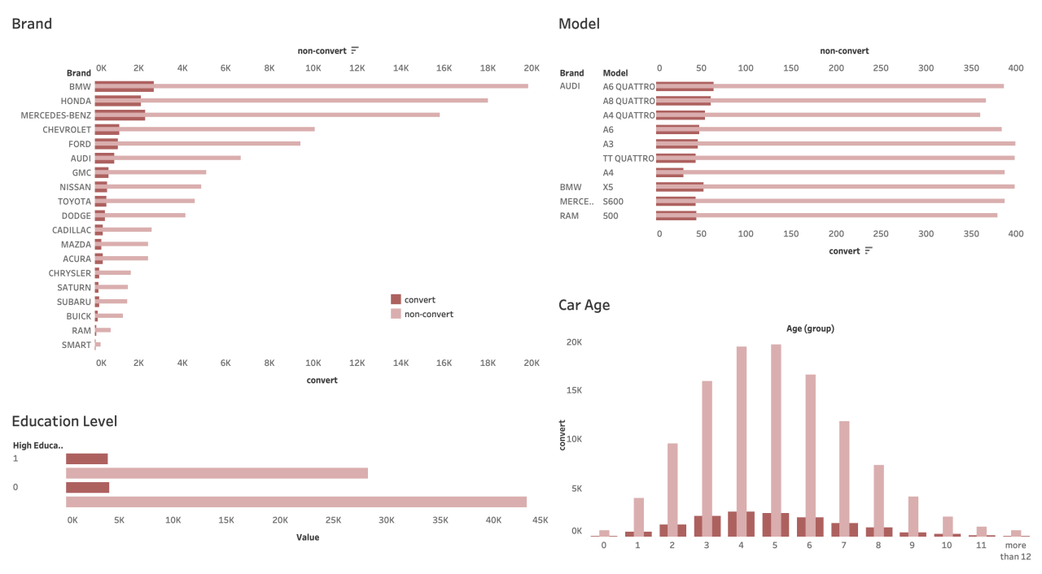
Data Exploration

Slide 14

Data Processing
04

Slide 15
Data Processing
Drivers
policy_id
Policies
policy_id
Vehicles
Merge Table
Attribute Encoding
Encoding Object: Categorical Variables
Encode categorical variable to numerical values will enable better data usage
Missing Values
To restrain data loss, we fill or transform missing values to better fit models
For large number variable (e.g. age), fill with average
For categorical variable, fill with 0/-1

Slide 16

05
Modeling

Slide 17

Modelling
Model Selection
Tree Model
A Tree model is a tree-like graph with the nodes representing the place where we pick an attribute and ask a question, leaves represent the actual output or class label. They are usually used for classification.
We implemented three tree-based model during the analysis, including:
Random Forest (Feature selection)
XGBoost
LightGBM
XGBoost
Cross Validation
Training
LightGBM
max AUC-ROC
XGBoost
Random Forest
Feature Importance
Testing
With the application of Cross Validation (resample and retrain), we select the model with the highest AUC as the optimal model. Also, we can obtain the order of important variables for intuitions.

Slide 18
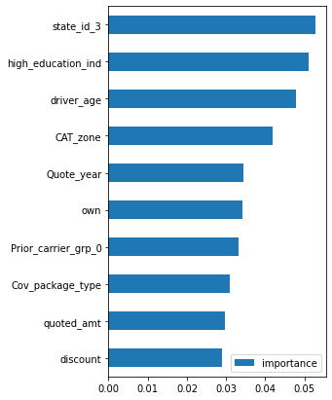
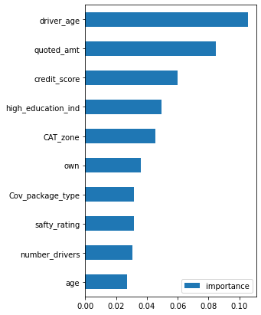
Feature Importance
Top 10 Importance Features by XGboost
Top 10 Importance Features by Random Forest
Notes:
driver age, quoted_amt, high education of driver have high influencial

Slide 19
Key Advantage
Deployable
Robustness
Effective
With all variables fully cleaned and transformed on github, our project is highly convertible to any team as a routine tracking benchmark.
The XGBoost Model, except can handle missing values, can also select important features during modelling based on explicit dataset. Also, with year as a attribute, long-term is practicable.
XGBoost use parallel processing, which is to utilize multiple cores to execute the model while training. That leads to high efficiency for potential BIG data deployment.
Notes:
streamline

Slide 20

06
Deployment and Intuition

Slide 21
Customer Segmentation
High-Conversion Group
Low-Conversion Group
Middle-Aged
High Credit Score
High Education
…
Young Generation
Low Credit Score
Low Education
…

Slide 22

High-Conversion Group Strategies
“Cost-Saving & Profit-Increasing”
ADVERTISING
MARKETING
PRODUCT
“Micro-targeting” advertising strategies
Specific promotion plan:
Family Bundle
Credit Discount
Help actuarial team to better understand the customer portrait: applied to product optimization
Notes:
Apply “micro-targeting” ad strategies (i.e. only send promotions to the high-conversion customers -> increase the efficiency of monetization conversion
Since we know some specific features that significantly lead to high conversion rate, we can launch new marketing strategies targeting on these groups.
We believe the information we collected can also Help actuarial team to better understand the portrait

Slide 23


Low-Conversion Group Strategies
PRICE DISCRIMINATION
TARGETED
MARKETING
SERVICE
IMPROVEMENTS
Insurance coupon for low-conversion customers
Gen-Z Branding
Once the low-conversion customers get the policies, additional customer services should be provided
Notes:
We can deliver some price discrimination strategies, for example, coupon attached with the quote policies
Just as we did in targeted marketing,

Slide 24
Further Improvements
The model is just a BENCHMARK for business analysis
It is a good metric that is flexible to be applied to operational analysis of any department in our business
Data analytics & product team should participate in more specific topics about the customers
Other useful variables that may improve the performance of the model
Car Price (original price / current market price)
Personal Income / Family Income
Brand cooperation with vehicle companies
Notes:
This model is just a benchmark

Slide 25

THANKS
Does anyone have any questions?
CSRR
Cindy (Xinyi) Zhang | xinyi.zhang2@emory.edu | linkedin.com/in/cindy-zhang-emory
Susie (Qingyang) Li | susie.li@emory.edu | linkedin.com/in/susie-qingyang-li
Rebecca (Ruixin) Li | ruixin.li@emory.edu | linkedin.com/in/rebecca-ruixinli
Roch (Runqing) Jia | roch.jia@emory.edu | linkedin.com/in/rochjia

